Slide 1
Ball Mill Grinder Project
-Sk Sartaz Ahmed

Slide 2
Mechanical Design & Materials

Slide 3
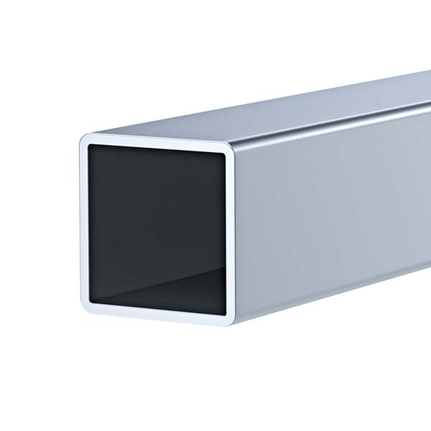
Material : Aluminum
1.3 inch
1.3 inch

Slide 4
1’’
2’’
2’’
1’’
1’’
1’’
1’’
1’’
Top View

Slide 5
40’’
17’’
16’’

Slide 6
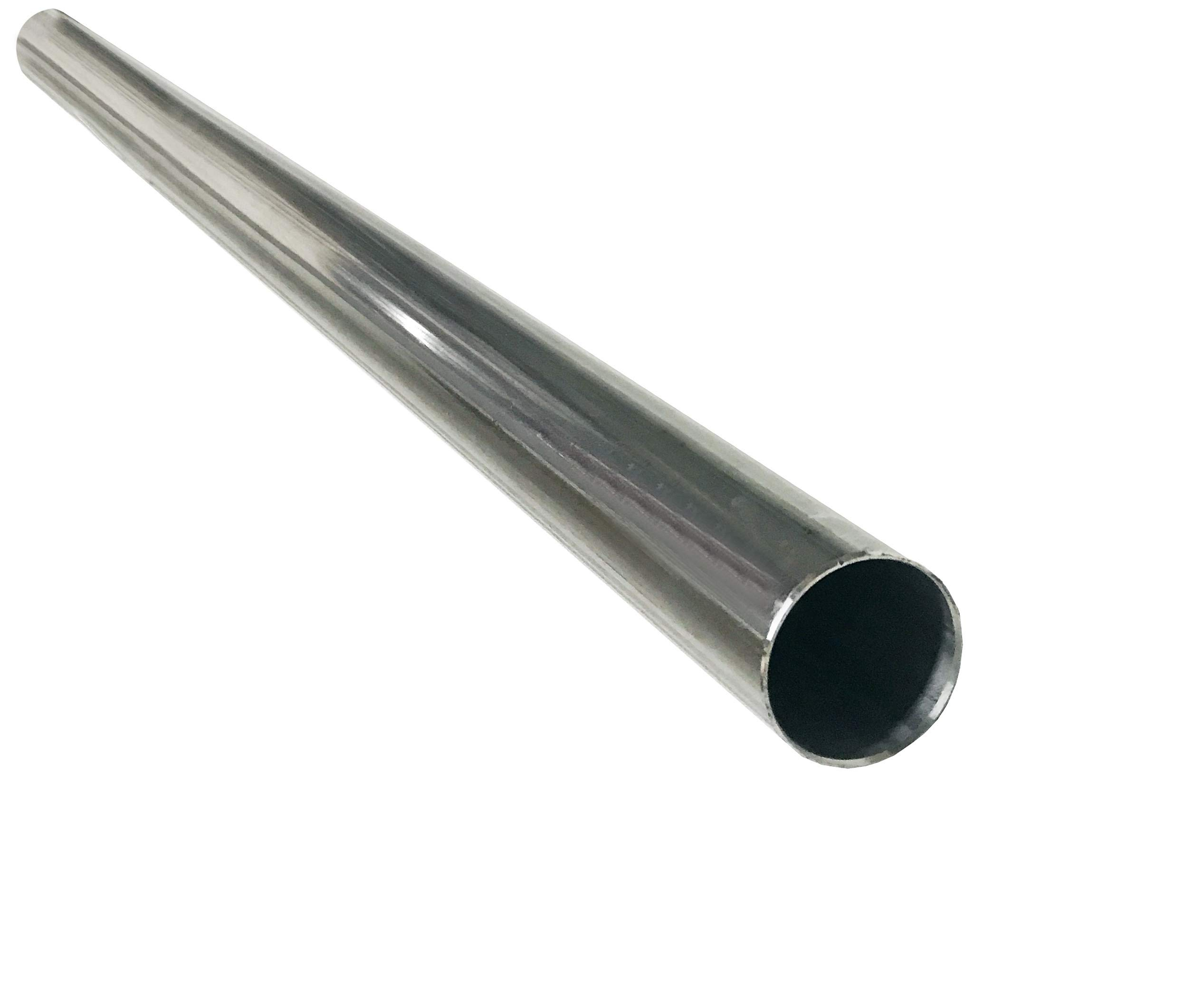
Material : Stainless Steel
0.5’’

Slide 7
M

Slide 8
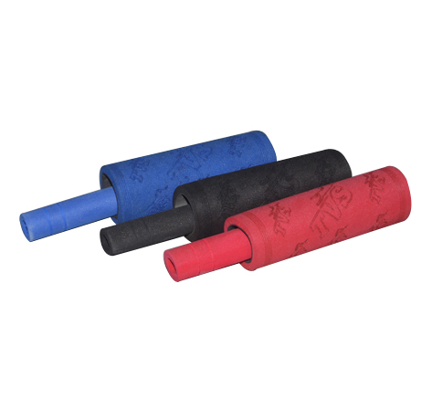
Material : Foam

Slide 9
M

Slide 10
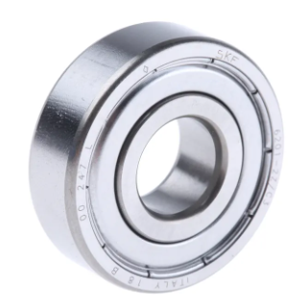
Material : Bearing steel ( AISI 521000 )
Number : 6201
Bore diameter : 0.5 inch
0.5’’

Slide 11
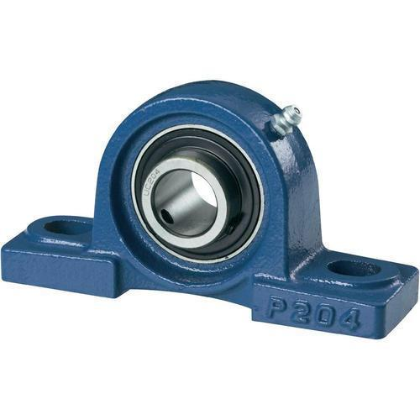
Material : Mild Steel

Slide 12
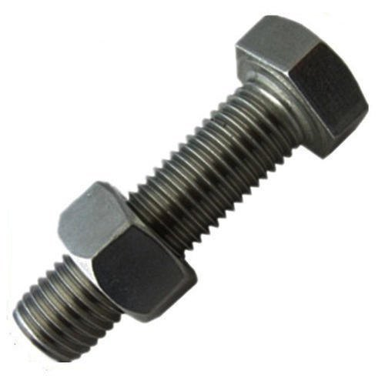
Material : Mild Steel
Size : 2 inch

Slide 13
M

Slide 14
M

Slide 15
1’’
M

Slide 16
M

Slide 17
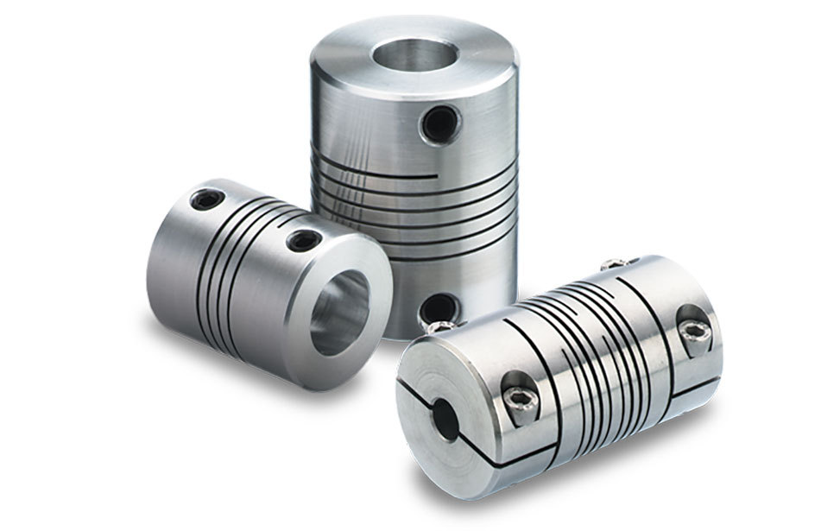
Material : Mild Steel

Slide 18
M

Slide 19
1
2
3
M

Slide 20
M

Slide 25
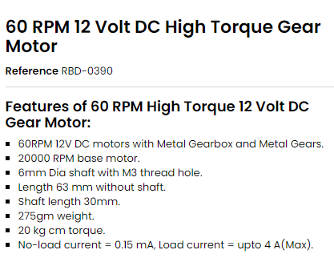
ω = 1 rev s⁻¹

Slide 26
2
V₁ = V₂
10cm
ω₁r ₁= ω₂r₂
Or, ω₂ = (ω₁r ₁)/r₂
2.5cm
Or, ω₂ = (ω₁r ₁)/r₂
1
Or, ω₂ = ( 1 X 1.25 )/5
Or, ω₂ = ( 1 X 1.25 )/5
Or, ω₂ = 1/4 rev s⁻¹

Slide 27
h
D
E= mgh

Slide 28
2
V₁ = V₂
10cm
ω₁r ₁= ω₂r₂
Or, ω₂ = (ω₁r ₁)/r₂
5 cm
Or, ω₂ = (ω₁r ₁)/r₂
1
Or, ω₂ = ( 1 X 2.5 )/5
Or, ω₂ = ( 1 X 2.5 )/5
Or, ω₂ = 1/2 rev s⁻¹

Slide 29
h
D
E= mgh

Slide 30
F=mω²r
F=mg

Slide 31
mω²r =mg
Or, ω²r =g
D=10 cm
Or, ω = √ (g/r)
Let’s assume r= 5cm
Or, ω = √ (9.81/0.05)
ω = 2.23 rev s⁻¹
Or, ω = 14 rad s⁻¹

Slide 32
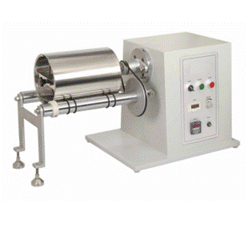
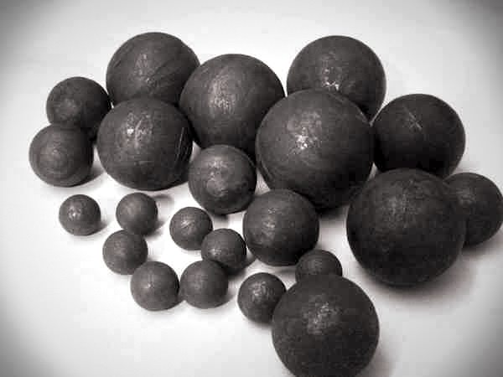

Slide 33

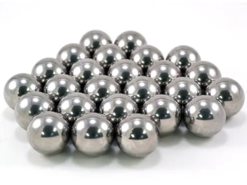

Slide 34
Building & Test Run

